Slide 1
ENVIRONMENTAL SCIENCE [EV20001]
Sudha Goel, Ph.D.
Associate Professor, Env Eng and Management Civil Eng. Dept., IITKgp
Kharagpur 721 302

Slide 2
Course objectives
Course objective is to ensure that students incorporate the concept of ‘sustainable development’ in their daily lives and decision-making processes and are sensitive to various environmental issues and the impacts of pollution
Learning objectives
To understand the relationship between humans and their environment
To quantify the relationship between population growth, resource consumption and pollution
To identify sources of pollution in the environment, their impacts and remedial measures
To apply the laws of conservation of mass and energy in understanding and solving environmental problems

Slide 3
Textbook and reference materials
Masters G and Ela WP (2012). Introduction to Environmental Engineering and Science. Prentice Hall, NJ, US.
Kormandy EJ (1995) Concepts of ecology, Prentice Hall of India, New Delhi.
Pepper IL, Gerba CP and Brusseau ML (2006) Environmental and Pollution Science, Academic Press, Elsevier.
Khoiyangbam RS and Gupta N (2015) Introduction to Environmental Sciences, TERI Press, Delhi
Davis ML and Masten SJ (2009) Principles of Environmental Engineering and Science, McGraw Hill Education, Indian edition.
Garg, SK (2006) Ecology and Environmental Studies, Khanna Publishers, New Delhi.
Slides and other uploaded materials

Slide 4
Syllabus (post-midsem, Spr 2018)
Week | Topics
1 | Population growth and resource consumption
2 | Ecology
3 | Hazardous waste management
4 | Solid waste management
5 | Solid waste management
6 | Soil and noise pollution
7 | Environmental Impact Assessment
8 | Class test

Slide 5
The Environment and its domains
Air Pollution and Control; Climate Change, light and noise pollution
Solid and Hazardous Waste Management; soil pollution
Lithosphere
Hydrosphere
Atmosphere
Biosphere
Water and wastewater treatment
Public Health and Ecology

Slide 6
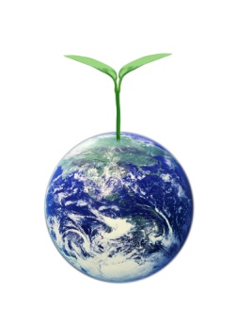
Sustainable development
Development that meets the needs of the present without compromising the ability of future generations to meet their own needs (Brundtland Report – Our Common Future, 1987)
Implications:
Societal emphasis has to shift from a destructive, exploitative philosophy (The Tragedy of the Commons*) to one that fosters long-term protection of the environment and its inhabitants (we have to protect The Golden Goose!)
Two conflicting objectives have to be reconciled
improving quality of life vs. protecting the environment
*Hardin, Garrett [1968] The Tragedy of the Commons, Science, 162:1243-1248.

Slide 7
Driving forces for sustainability
Health and safety: human and other organisms
Financial: property values, profits, taxes
Aesthetics
Civic pride and values
THE LAW
All the good intentions in the world are not equal to the arm of law
Our biggest challenge in this new century is to take an abstract idea like sustainable development and turn it into reality for all the world’s people – Kofi Annan, 2001

Slide 8
The Law and its course
Water (Prevention and Control of Pollution) Act- 1974, amended 1988
Air (Prevention and Control of Pollution) Act- 1981, amended 1987
Environment Protection Act – 1986, amended 1991
Municipal Solid Waste (Management and Handling) Rules – 2000 and more…..
Hazardous Waste (Management and Handling) Rules - 1989
Biomedical Waste Handling rules - 1998

Slide 9
More about the law……..
Regulations | Year of notification | Year of last amendment
Water (Prevention and Control of Pollution) Act | 1974 | 1988
Air (Prevention and Control of Pollution) Act | 1981 | 1987
Environment Protection Act | 1986 | 1991
Hazardous Waste (Management and Handling) Rules | 1989 | 2009
Biomedical Waste Handling Rules | 1998 | 2003
Flyash Rules | 1999 | 2007
Recycled Plastics Usage Rules | 1999 | 2003
Municipal Solid Waste (Management and Handling) Rules | 2000 | 2001/ 2016
Batteries (Management and Handling) Rules | 2001
Plastic Waste (Management and Handling) Rules | 2011
E-waste (Management and Handling) Rules | 2011 | 2015
Construction and demolition waste management rules | 2016

Slide 10
What is a pollutant or contaminant?
A pollutant is a chemical species in the environment that causes undesirable effects on the environment or any of its components.
Can be natural or anthropogenic
Undesirable effects
Endangers health of humans and other organisms
Endangers safety
Causes financial and aesthetic losses
Contamination is simply the presence of a substance where it should not be or at concentrations above background. Pollution is contamination
that results in or can result in adverse biological effects to resident communities.

Slide 11
Why is pollution increasing?
Population Growth
Pollution
Resource Consumption
More waste generated
More resources consumed
Higher standard of living
Increase in population
Notes:
Examples of this phenomena: Pollution due to use of fossil fuels in vehicles, thermal power plants; untreated or partially treated wastewater discharges to rivers……

Slide 12
Population growth
World Population = 7.44 billion
India’s population = 1.33 billion
West Bengal’s population = 90.3 million
Kharagpur’s population = 4.0 lakhs
If data from 1911 to 2011 are used
Average annual total population growth rate = 1.75%
Average annual urban population growth rate = 2.85%
http://www.census.gov/popclock/
All figures for 19 July 2016

Slide 13
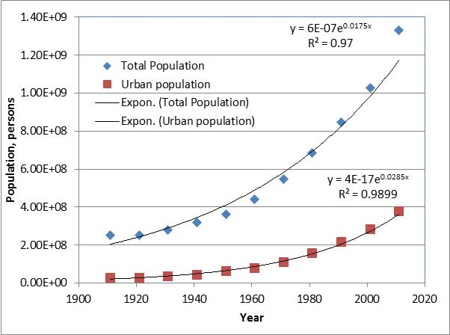

Slide 14
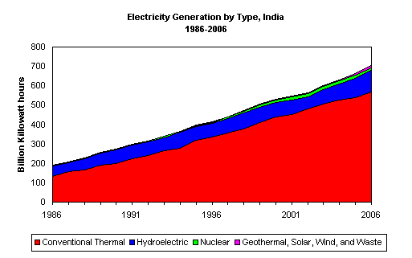
Resource consumption
http://www.eia.doe.gov/cabs/India/Full.html

Slide 15
Power generation in India
Annual increase in per capita power consumption in India = 4.61%
Notes:
Wikipedia, 2015
A non-renewable resource (also called a finite resource) is a resource that does not renew itself at a sufficient rate for sustainable economic extraction in meaningful human time-frames. An example is carbon-based, organically-derived fuel. The original organic material, with the aid of heat and pressure, becomes a fuel such as oil or gas. Earth minerals and metal ores, fossil fuels (coal, petroleum, natural gas) and groundwater in certain aquifers are all non-renewable resources.
The renewable energy from the sun, wind, wave, biomass and geothermal energies are based on renewable resources. Renewable resources such as the movement of water (hydropower, tidal power and wave power), wind and radiant energy from geothermal heat (used for geothermal power) and solar energy (used for solar power) are practically infinite and cannot be depleted, unlike their non-renewable counterparts, which are likely to run out if not used sparingly.

Slide 16
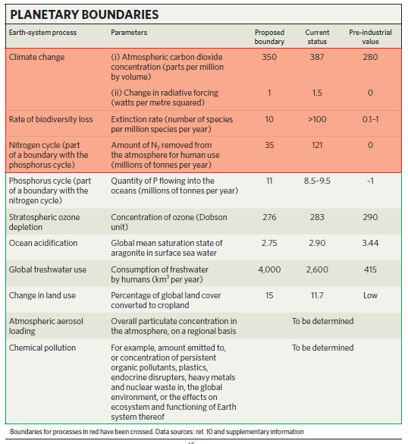
409
Rockstrom et al., 2009. A safe operating space for humanity, Nature, 461: 472-475

Slide 17
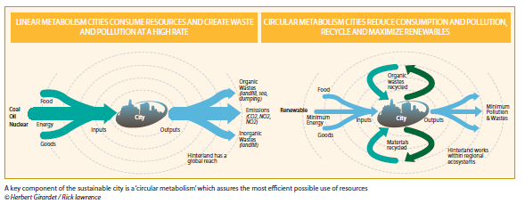
TAKE – MAKE - DISPOSE
TAKE – MAKE - RECREATE
CRADLE – TO - GRAVE
CRADLE – TO - CRADLE
Girardet, H (2009) Regenerative cities, World Future Council, Germany

Slide 18
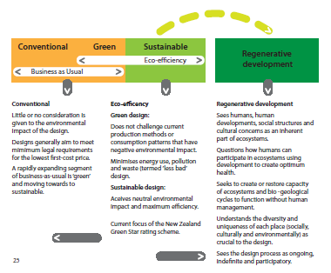
Girardet, H (2009) Regenerative cities, World Future Council, Germany

Slide 19
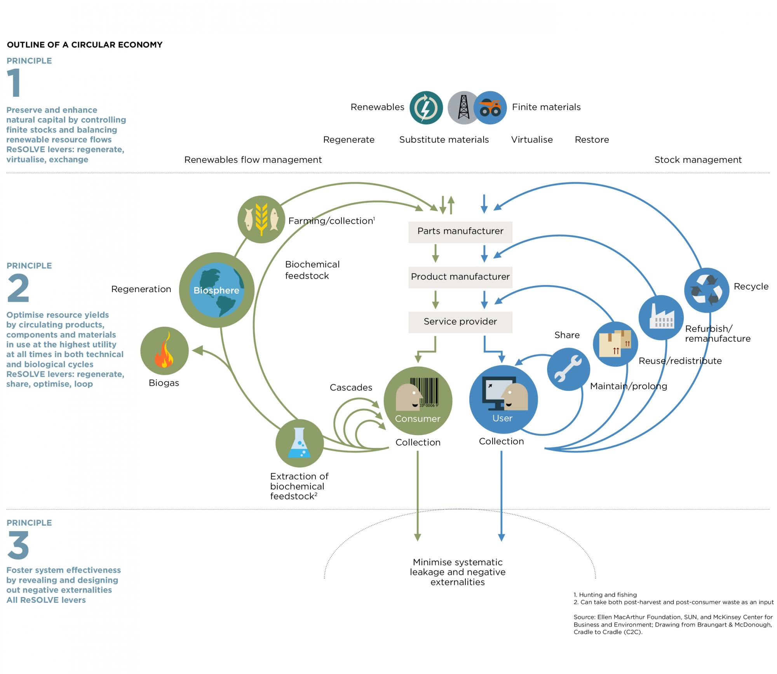
Circular Economy: A System Diagram
https://www.ellenmacarthurfoundation.org/circular-economy/interactive-diagram

Slide 20
Problems
World population in 1975 was 4 billion and in 2015 it was 7 billion. Determine the annual exponential population growth rate and predict the world’s population in 2030.
The average annual exponential population growth rate for India is 1.84% and the urban population growth rate is 3%. The total population in India in 2011 was 1.21 billion and the urban population was 0.38 billion. If these growth rates continue in future, determine the year in which the urban population will be 50% of the total population in India.
Why is the urban population growth rate higher than the total population growth rate?
What can be done to slow this growth?
In 2010, the total installed electricity generating capacity of thermal power plants in India was 125 GW. The current annual exponential per capita growth in electricity consumption is 4.6%. Assuming ‘business-as-usual’, what is the thermal power plant capacity requirement for 2030 and 2050?
The current (2017) carbon dioxide concentration is 408.84 ppmv and the following data are available for the past:
1965 – 320 ppmv, 1975 – 331 ppmv, 1985 – 346 ppmv, 1995 – 361 ppmv; 2005 – 384 ppmv. Based on these data, estimate concentrations for 2018; how close is your estimate to the concentration measured today.
Predict the concentration in 2030 and 2050 at current growth rates.

Slide 21
THANK YOU

